Slide 1

Data Science Sharing Session
Optimization Applications
In this sharing session we will explore about what is optimization and it’s applications that we can use as Data Scientist to deliver solutions using Data.
Benedict Aryo

Slide 2
Optimization
What and why does it matter ?
I think the best way to answer this question is to look into our daily life as a data scientist, start from what we do, what question we can answer or what problem that we can solve using data science.

Slide 3
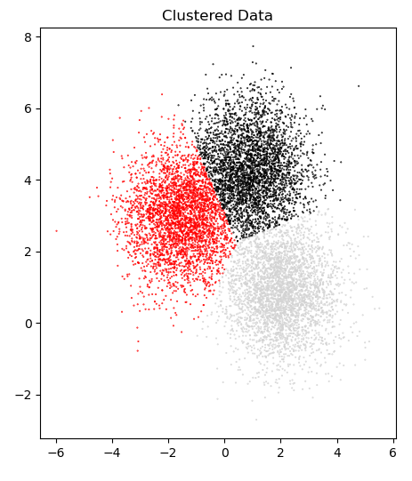
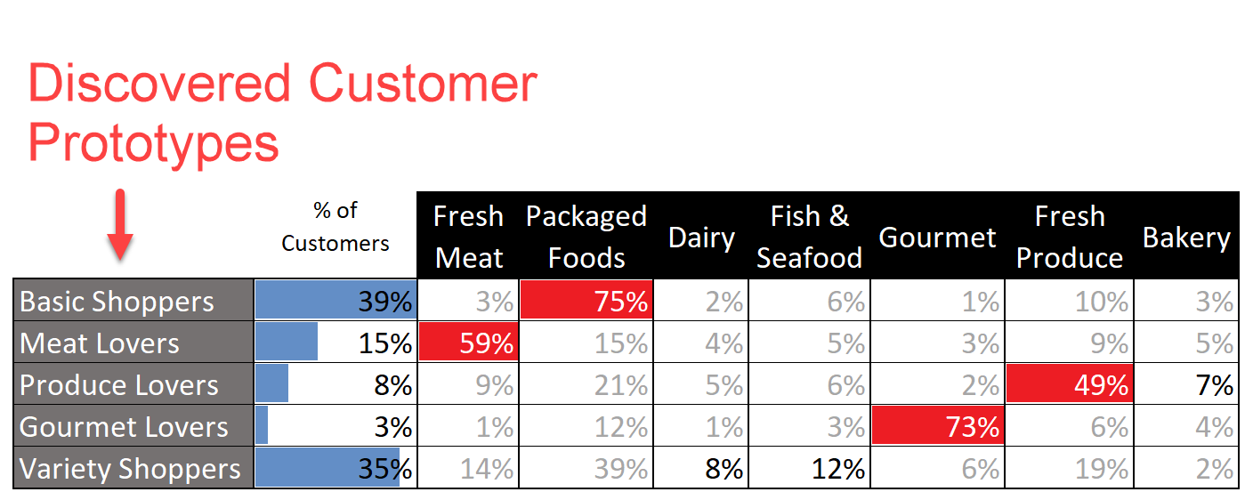
How is it Organized ?
We typically use unsupervised machine learning method to find pattern in the data
There are a wide variety of techniques that try to tease out the structure of data. One of these techniques are clustering, or segmentation. We separate out a dataset into intuitive chunks which gives us meaningful insights.

Slide 4
Given the data of variables,
How Much/Many is x ?
(Regression Analysis)
Sometimes, we found a case where we required to deliver estimation or prediction of continuous value such as temperature data, sales forecasting, commodity price, etc.
Usually, we will try to model the data using Regression machine learning, and to decide which regression model we should use, we will analyze the relationship of the predictors variables whether it’s linear or non linear then decide the regression algorithm we should use.

Slide 5
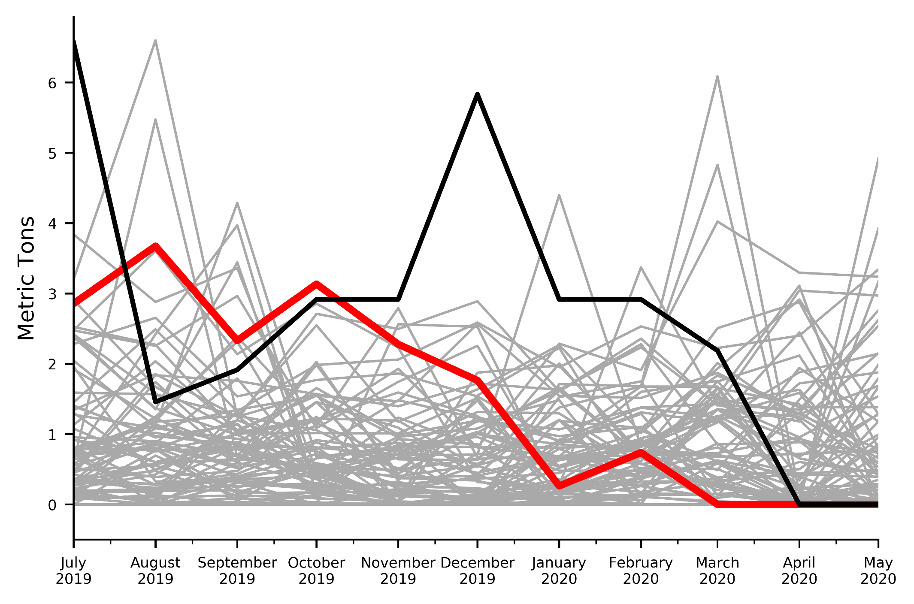
Products with Zero Sales
Some Products may have 0 MT sold
In the group of products with small sales cap it’s common that we see in particular month there are products with Zero national sales.
The problem is in current accuracy calculation, if the real value is zero, and we predict any number other than zero, the accuracy calculation for that product will be 0%.
We need to have a good mechanism to give early detection for discontinue product or warning for certain product whether it has probability to be zero sales based on historical data.

Slide 6
Sales Forecasting
Proposed Strategies
We formulate our common problems that currently we face, which prevent us from having good result in the Sales Forecasting project

Slide 7
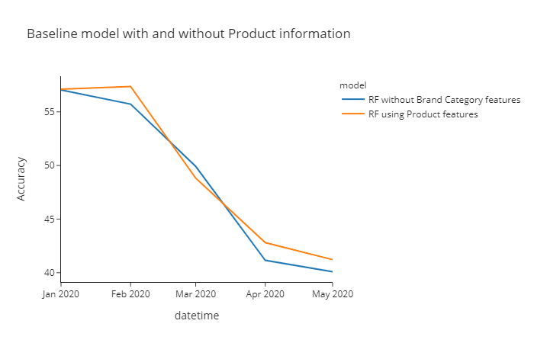
Improve model by adding more features
Adding Artificial features and Product related features
We keep improving our model accuracy by tuning the model and experimenting with features that we use as input to the model.
This strategy including adding Product related features (feature that we extracted from product that we want to predict) such as product brand and category, or Artificial features (feature that we generated by formula or computation) such as lag, smoothing or leading indicator probability.

Slide 8
Mapping Model weakness
Analyze the drawback of model created by criteria
Currently when we are creating forecasting model we compete the overall performance of the prediction by aggregating the accuracy score, we want to analyze the weakness of the model.
So when we Optimize the model to increase the accuracy, we can really monitor the performance for each criteria/category we need to improve..
Model \ Category | Model 1 | Model 2 | Model 3
Category 1 | 65% | 32% | 70%
Category 2 | 78% | 52% | 28%
Category 3 | 33% | 67% | 54%

Slide 9
Utilize multiple model
Increase flexibility in term of model and features being used
If we found that the one model that we optimize still having less performance than we expected, we can also utilize more than one model to increase the forecasting accuracy.
Each model can utilize different features or targeting different category.
We can also use some voting algorithm to weight more certain model.
Model 1
Submit
Forecasting
Separating Category,
Voting,
Probability, etc
Prediction
Model 2

Slide 10
Currently running plan
Standardized Experimentation
We are creating modular framework to bring the result of experimentation into production ready forecasting as quickly as possible.
Because, at the end of the day, no matter what our model experiment result or at what stage we’re currently at improving the model, we still need to deliver our sales forecasting prediction every month.
This including pipeline for training & forecasting and database preparation to store the prediction so it can be served to user as forecast submission report or as dashboard production

